Slide 1
“Wetlands in Crisis: Understanding the Impact of Heavy Metals and Plastic Pollution”
Presented by: Dr. Nkosi Mwansa,
University of Zambia (UNZA)

Slide 2
Introduction
Opening Statement:
“Good morning, colleagues and environmental stewards. Today, I bring to your attention a pressing environmental emergency—one that is silently but steadily destroying one of our most vital ecosystems: wetlands.”
Objective of the Presentation:
To share the findings of a five-year multi-site study examining the extent of human-induced contamination in Zambia’s wetlands, specifically focusing on:
Heavy metal infiltration
Plastic pollution trends
Potential ecological and public health impacts

Slide 3
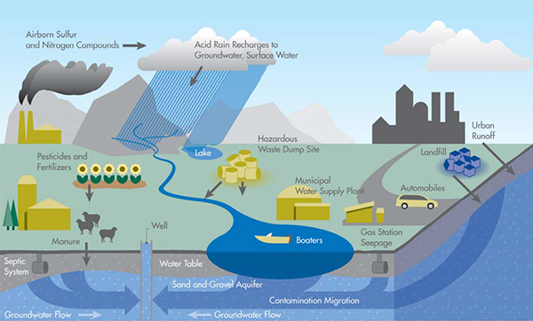

Slide 4
Why Wetlands Matter
Wetlands occupy 6% of Zambia’s land area, supporting over 40% of the country’s biodiversity.
They act as natural water filters, flood regulators, and carbon sinks.
Also home to countless fish species, birdlife, and vital to local agriculture and livelihoods.

Slide 5
Key Finding #1 — Heavy Metal Contamination
78% of all sampled wetlands contained dangerous levels of at least one heavy metal.
Highest concentrations found near:
  Mining zones (Copperbelt): Lead & Cadmium
  Urban drainage sites (Lusaka): Mercury & Arsenic
In some cases, Lead levels were 4.5 times above WHO guidelines for safe freshwater use.
Bioaccumulation observed in fish and amphibians, indicating entry into the food chain.

Slide 6
Study Overview
Research Period: 2018–2023
Sample Sites: 22 wetlands across Copperbelt, Lusaka, Central, and Luapula Provinces
Parameters Tested:
  Heavy metals (Lead, Mercury, Arsenic, Cadmium)
  Plastic presence (macro- and micro-plastics)
  Water pH, turbidity, and biological indicators

Slide 7
Key Finding #2 — Plastic Pollution Surge
Between 2015 and 2023, plastic waste in wetlands has increased by over 300%.
  2015 baseline: 180 pieces/km²
  2023 reading: 740 pieces/km² (avg.)
60% of this waste originates from household waste, while 25% comes from industrial packaging and 15% from fishing activities.
Microplastic particles now detected in:
  Surface water
  Sediment
  Benthic invertebrates

Slide 8
Implications of the Findings
Environmental:
Loss of aquatic biodiversity (e.g., decline in frog and tilapia populations)
Altered ecosystem functioning—filtering, breeding, and carbon storage capacity at risk
Human Health:
Potential exposure to heavy metals through consumed fish and vegetables
Long-term consequences include neurological, reproductive, and cancer risks
Economic:
Local communities face declines in fishing yields
Eco-tourism potential threatened due to poor environmental quality

Slide 9
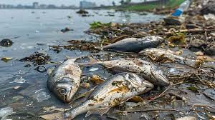

Slide 10
Urgent Call to Action
Policy Recommendations:
National Wetlands Protection Act enforcement
Mandatory waste treatment for industrial outflow
Plastic reduction campaigns targeting urban markets
Establish community-based wetland monitoring units
Create buffer zones around high-risk wetlands

Slide 11
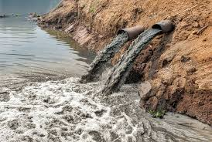

Slide 12
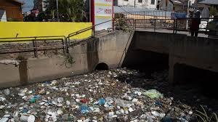

Slide 13
Community Engagement
Mobilize school-based environmental clubs
Introduce plastic buy-back or recycling incentives
Encourage citizen science through mobile reporting of pollution incidents

Slide 14
Conclusion
“We are standing at a pivotal moment. The data is clear, the trend is disturbing, and the time to act is now. Wetlands are not wastelands—they are life support systems. Let us protect them before the damage becomes irreversible.”
Image Copyright: getty images

Slide 15
Q&A
“Thank you for your attention. I welcome your questions, thoughts, and collective ideas for safeguarding our wetland ecosystems.”

